Slide 1
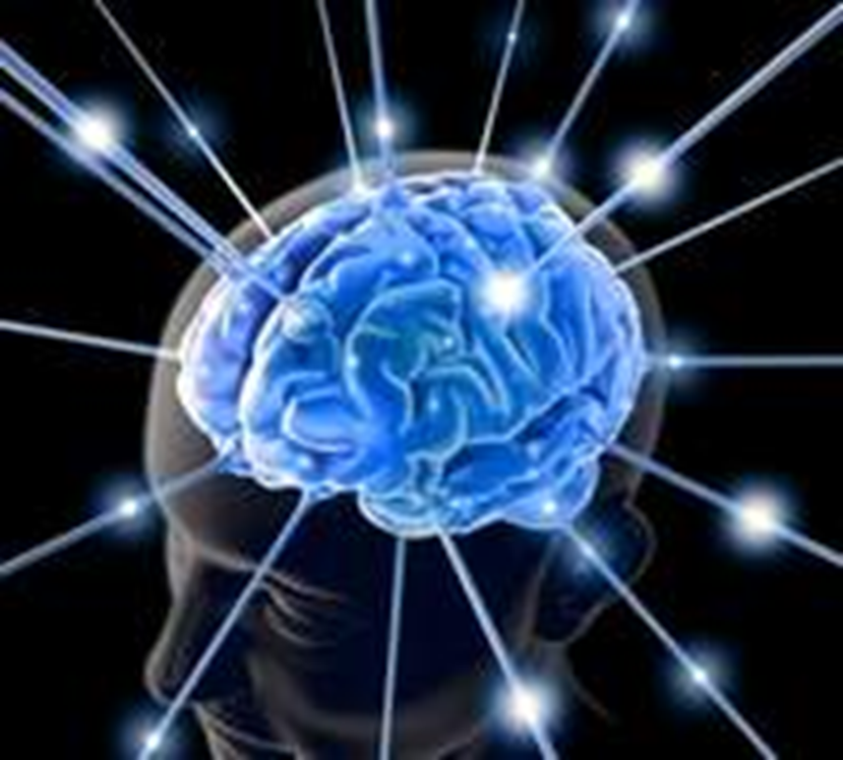
Critical Thinking
Notes:
THE NATURE OF HUMAN BEINGS - MAN'S FREEDOM

Slide 2

What is thinking?
A purposeful, organized cognitive process that we use to make sense of our world.
Expresses man’s nature as a rational being (essential difference)
Types of thinking:
Critical Thinking (evaluative)
Creative Thinking (to bring forth new ideas).

Slide 3
What then is Critical Thinking?
Etymology: “Kriticos” - discerning judgement, “Kriterion”– standard.
A systematic way of thinking that gives clarity, confirmation and coherence to our ideas, inferences or judgements.
Thinking open mindedly by examining points of view and acknowledging assumptions within a given point.

Slide 4
Disposition for CT
Putting various information together in a critical but systematic way.
Questioning Matters that do not make sense.
Example: challenging the validity of certain reasoning patterns of what we read in the news papers, blogs, Magazines; watch on TV etc.
Judging whether purported evidence supports the conclusion. This has to do more with character assassination, blackmail etc.

Slide 5
Pillars of Critical Thinking 1
Conceptual Clarity: Concepts and words are the vehicles of our ideas.
The analysis of propositions depends on the analysis of concepts. Define concepts first.
Identify the problem the following statements:
“The only thing in life that people value is pleasure”.
“Everyone is either formally educated or informally educated”.

Slide 6
Pillars of Critical Thinking II
Confirmation (experiential): Facts that are our ideas must relate to the facts that are the objects in the world – Truth.
What do you think about the claim below?
“There is no truth out there; nothing is good or bad, it all depends on what each person feels or thinks”.

Slide 7
Pillars of Critical Thinking III
Coherence: Agreement of the body of propositions with each other.
Acknowledging unstated assumptions within a given point.
What do you think about the statements below?
“We cannot know anything for certain”.
“Our actions are determined by psychological influences beyond our control. We should be morally responsible for our actions”.

Slide 8
Steps in CT
Data collection:
The human mind is constantly gathering data through the five senses which it uses to make judgment about realities.
Evaluating facts:
It is important to ask questions regarding significance, relevance and application of the facts to the situation at hand.
Drawing conclusion using logical tool – analysis, inferences.

Slide 9
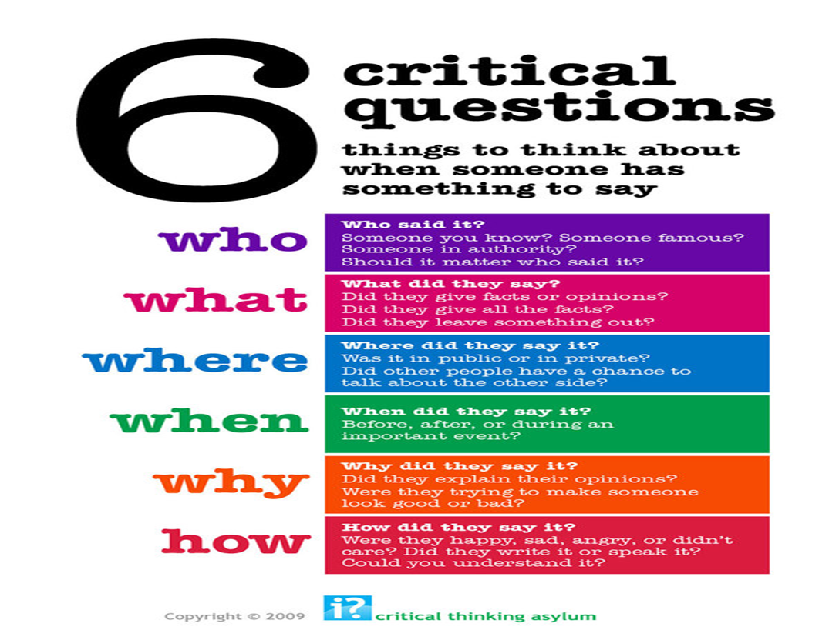

Slide 10
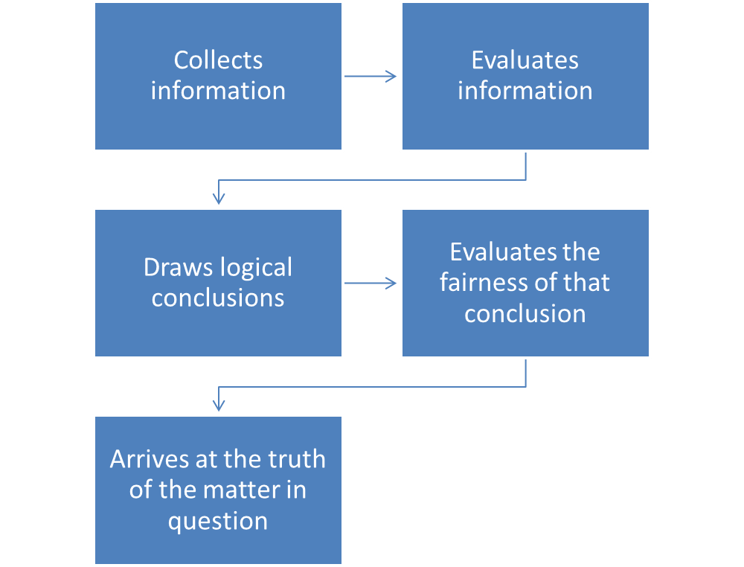
Summary of Critical Thinking Method

Slide 11
Commit to Memory
Always examine all facts and evaluate them critically before basing conclusions on them.
Avoiding fallacies is an important objective for a critical thinker.
Trust should not always override a need for verification.
We need to think critically about our decisions

Slide 12
What would be your answer to the following questions:
What am I or Who am I?
Why do I exist?
What do I exist for?
Am I a chance product of cosmic evolution?
Is there God? Where is He?
What is happiness?
What is the place of others in my life?

Slide 13
Whichever way you answer the foregoing questions, will define your worldview and your entire existence.
To answer them well, you need to rethink the ideas you took for granted.

Slide 14

Notes:
THE NATURE OF HUMAN BEINGS - MAN'S FREEDOM

